Slide 1
Unit - 1: Introduction
Reference Books
Professional Android 4 Application Development – Reto Meier
Beginning Android 4 Application Development – Wei-Meng Lee
Beginning Android Programming with Android Studio – J. F. DiMarzio (4th Edition)
Android Cookbook – Ian F. Darwin , O’REILLY (2nd Edition)
Web References

Slide 2
Prior to Android ....
Mobile Application Developers of low level programming with C and C++ needed to understand the specific hardware.
Platforms such as Symbian were later created to provide developers with a wider target audience.
  Although these platforms make heavy use of proprietary APIs that are difficult to work with.
Java hosted MIDlets (Mobile Information Device) were also introduced, which are executed on JVM.
  MIDlets provided abstraction for faster development, but device hardware access became restricted.
  Third party applications development and deployment is difficult

Slide 3
What is Android?
Android is a mobile operating system that is based on a modified version of Linux.
  Originally developed by Android, Inc. In 2005
  Later, Google purchased Android and took over its development work (July-2005)
  The first Android mobile handset, the T-Mobile G1, was released in the US in October, 2008.
  Android is continually developed by Google and the Open Handset Alliance (OHA)

Slide 4
What is Android?
    OHA is a collection of more than 80 technology companies, including H/W manufacturers, mobile carriers, S/W developers, semiconductor companies and commercialization companies.
The core Android source code is known as Android Open Source Project (AOSP), and is primarily licensed under the Apache License.
Vendors like hardware manufactures can add their own proprietary extensions to Android and customize Android to differentiate their products from others.

Slide 5
What is Android?
Android is also associated with a suite of proprietary software developed by Google, called Google Mobile Services (GMS) that very frequently comes pre-installed in devices
  which usually includes
    Google Chrome web browser
    Google Search and
    always includes core apps for services such as Gmail, as well as the application store and digital distribution platform Google Play
  These apps are licensed by manufacturers of Android devices certified under standards imposed by Google

Slide 6
Android v/s Others
Platforms like Microsoft’s Windows Phone and the Apple iPhone also provide a richer, simplified development environment for mobile applications.
However, unlike Android, they are built on proprietary operating systems. In some cases,
  they prioritize native applications over those created by third parties
  restrict communication among applications and native phone data
  restrict or control the distribution of third party applications to their platforms

Slide 7
Android v/s Others
Android offers new possibilities for mobile applications by offering an open development environment built on open source Linux kernel.
In Android, H/W access is available to all applications through a series of API libraries.
Application interaction is fully supported in Android.
In Android, all applications, third party or native, have equal standing, as they are written with the same APIs and are executed on the same run time.
  User can remove and replace any native application with a third party developer’s alternative.

Slide 8
Android Versions and their Names
Android 1.5: Android Cupcake
Android 1.6: Android Donut
Android 2.0: Android Eclair
Android 2.2: Android Froyo
Android 2.3: Android Gingerbread
Android 3.0: Android Honeycomb
Android 4.0: Android Ice Cream Sandwich
Android 4.1 to 4.3.1: Android Jelly Bean
Android 4.4 to 4.4.4: Android KitKat
Android 5.0 to 5.1.1: Android Lollipop
Android 6.0 to 6.0.1: Android Marshmallow
Android 7.0 to 7.1: Android Nougat
Android 8.0 to Android 8.1: Android Oreo
Android 9.0: Android Pie
Android 10.0: Android 10
Android 11.0: Android 11

Slide 9
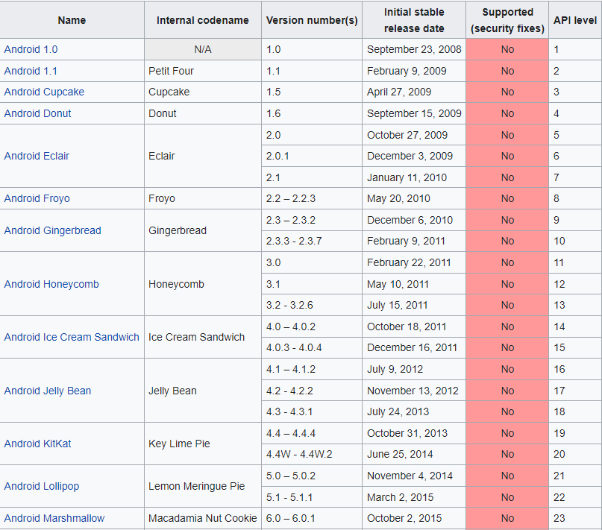
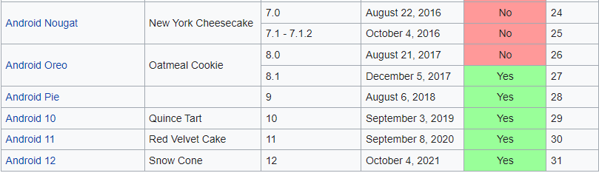
Android Version History
(https://en.wikipedia.org/wiki/Android_version_history)

Slide 10
Android API Level
Each Android device runs at exactly one API level – this API level is guaranteed to be unique per Android platform version.
The API level precisely identifies the version of the API set that your app can call into; it identifies the combination of manifest elements, permissions, etc. that you code against as a developer.
Android's system of API levels helps Android determine whether an application is compatible with an Android system image prior to installing the application on a device.
When an application is built, it contains the following API level information:
  The target API level of Android that the app is built to run on.
  The minimum Android API level that an Android device must have to run your app.

Slide 11
Android API Level
(https://docs.microsoft.com/en-us/xamarin/android/app-fundamentals/android-api-levels?tabs=windows)
These settings are used to ensure that the functionality needed to run the app correctly is available on the Android device at installation time.
If not, the app is blocked from running on that device.
For example, if the API level of an Android device is lower than the minimum API level that you specify for your app, the Android device will prevent the user from installing your app.

Slide 12
Features of Android
Storage: Uses SQLite, a lightweight relational database, for data storage.
Connectivity: Supports GSM/EDGE, IDEN CDMA, EV-DO, Bluetooth, Wi-Fi, LTE, NFC, and WiMAX.
Messageing: Supports both SMS and MMS.
Web browser: Based on the open source WebKit

Slide 13
Features of Android
Media support: Includes support for the media in form of MPEG-4, MP4, MP3, MIDI, WAV, JPEG, PNG, GIF, BMP, and many more.
Hardware support: Accelerometer Sensor, Camera, Digital Compass, Proximity Sensor, and GPS.
Multi-touch:
Multi-tasking:
Flash support:
Tethering: supports sharing of Internet connections as a wired/wireless hotspot.

Slide 14
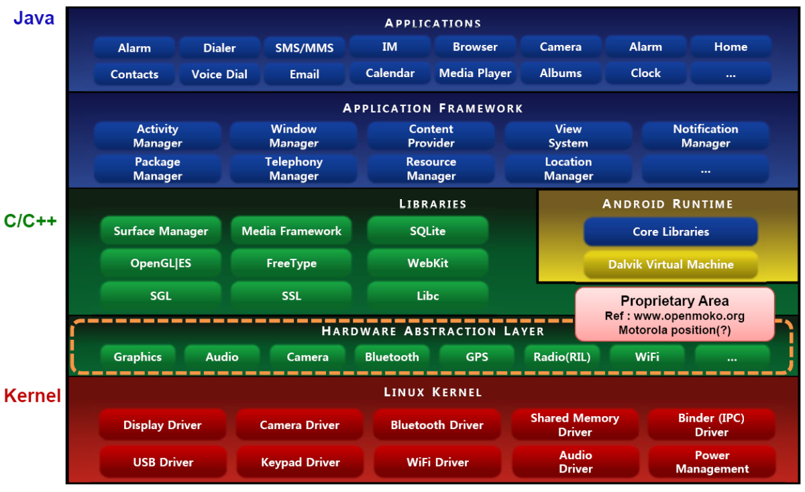
Architecture of Android

Slide 15
Architecture of Android
The Android OS is made up various layers.
The Android OS is roughly divided into five sections in four main layers.
  Linux Kernel
  Libraries
  Android Runtime
  Applications Framework
  Applications

Slide 16
Linux Kernel
This is the kernel on which Android is based.
This layer contains all the low-level device drivers for the various hardware components of an Android device.
Kernel also provides an abstraction layer between the hardware and the remainder of the stack.

Slide 17
Libraries
Running on top of the kernel, Android includes various C/C++ core libraries.
These contain all the code that provides the main features of an Android OS.
For example,
  The SQLite library for native database support
  The SSL and WebKit for integrated web browser and Internet security.
  Media library for playback of audio and video media
  Surface manager to provide display management

Slide 18
Android Runtime
Android runtime includes core libraries and Dalvik VM.
At the same layer as the libraries, the Android runtime provides a set of core libraries that enable developers to write Android apps using the Java programming language.
It includes Dalvik Virtual Machine, which enables every Android application to run in its own process, with its own instance of the Dalvik Virtual Machine.
  Android applications are compiled into Dalvik executables.
  Dalvik is a specialized virtual machine designed specifically for Android and optimized for battery-powered mobile devices with limited memory and CPU.

Slide 19
Application Framework
Application framework exposes the various capabilities of the Android OS to application developers so that they can make use of them in their applications.
It provides the classes used to create Android applications.
It also provides a generic abstraction for hardware access and manages the user interface and application resources.

Slide 20
Applications
At this top layer, we find applications that ship with the Android device, such as Phone, Contacts, Browser, etc.
The applications that one can download and install from the play store, are also found in this layer.
Any application that one writes is located at this layer.
The application layer runs within the Android runtime, using the classes and services made available from the application framework.

Slide 21
Types of Android Applications
Foreground: An application that is useful only when it is in the foreground and is effectively suspended when it is not visible.
  For example, Games
Background: An application with limited interaction that spends most of its lifetime hidden.
  These applications are less common
  For example, SMS auto-responders, alarm clock

Slide 22
Types of Android Applications
Intermittent: most well designed applications fall in this category;
  At one extreme are applications that expect limited interactivity but do most of their work in the background. For example, Media Player.
  At the other extreme are applications that are typically used as foreground applications but that do important work in the background . For example, E-mail, News applications.
Widgets and Live Wallpapers:
  An application may consist entirely of a Widget or Live Wallpaper.
  By creating widgets and live wallpapers, one provides interactive visual components that can add functionality to user’s home screen
  Widgets are commonly used to display dynamic information, such as battery level, weather forecasts, or the date and time.
  Widgets are also used to invoke an activity when tapped.

Slide 23
Dalvik Virtual Machine
Android uses its own custom VM designed to ensure that multiple instances run efficiently on a single device.
The DVM uses the device’s underlying Linux kernel to handle low-level functionality including;
  Security
  Threading
  Process & Memory management
If speed and efficiency of C/C++ is required for an application, Android provides a Native Development Kit (NDK).
  NDK enables developer to create C++ libraries using the libc and libm libraries
  NDK enables access of OpenGL

Slide 24
Dalvik Virtual Machine
All Android hardware and system service access is managed using Dalvik as a middle tier.
By using VM to host application execution, developers have an abstraction layer that ensures they should never have to worry about a particular hardware implementation.
The DVM executes Dalvik executable files (.dex), a format optimized to ensure minimal memory footprint.
.dex is created by transforming Java language compiled classes using the tools supplied within the SDK.

Slide 25
Difference between .dex and .apk
DEX (Dalvik Executable)
  DEX is binary file format, so it is compiled.
  We could say, that .dex file is for DVM (Dalvik Virtual Machine) something like .class files for JVM.
  DEX file format is generated from java CLASS files by dex compiler from Android SDK.
  This compiler translates JVM bytecode to DVM bytecode and put all class files to one .dex file.
APK (Android Application Package)
  APK is file format designed for distributing Android application on its platform.
  It has some similarities with JAR format. Again it is simple just ZIP archive, but APK files have pre-defined specific structure.
  For example, it always must contains file named AndroidManifest.xml and many more.
  Also this package aggregates compiled classes in dex format.

Slide 26
Key Android Concepts
Android SDK : The Android Software Development Kit (SDK) contains a Android APIs, Development tools, AVD Manager and emulator, debugger, libraries, documentation, sample code, and tutorials.
Android SDK Manager: manages the various versions of the Android SDK currently installed on your computer.
Android Virtual Devices (AVDs): used for testing Android application.
  An AVD is an emulator instance that enables you to model an actual device.
  You can create as many AVDs as you want in order to test your applications with several different configurations.

Slide 27
Key Android Concepts
Android Development Tools (ADT): is an extension to the Eclipse IDE that supports the creation and debugging of Android applications.
One can do following using ADT:
  Create new Android application projects
  Access the tools for accessing your Android emulators and devices
  Compile and debug Android applications
  Export Android applications into Android Packages (APKs)
  Creating digital certificates for code-signing your APK.

Slide 28
Android Application Components
Intent
Activity
Service
Broadcast Receiver
Content Provider
Synch Adapters

Slide 29
Activity
An activity is a window that contains the user interface of your application.
An activity comprises the visual components (“views”) for one screen as well as the code that displays data into that screen and can respond to user events on that screen.
Almost every application has at least one activity.

Slide 30
Activity
An Android application may consists of a number of activities.
Each activity is a single user interface screen.
One activity may invoke another activity.
Android maintains an Activity Stack.
The activity that the user is currently interacting with is always at the top of the Activity Stack.
When that activity starts another activity, the newly started activity is pushed on the top of the stack.
When the newly started activity finishes, it is popped from the Activity Stack, bringing the previous activity to the top of the stack again.

Slide 31
Service
A service is a component that has no user interface, and can run for a longer period of time than an Activity.
Two main uses for services are
  for long running tasks such as a music player, and
  running medium-length tasks without tying up the user-interface thread.
Services are used for performing functions that are to be performed periodically without the user invoking the application or for taking some action when particular event occurs.
Services are also used to take some action in response to some event

Slide 32
Broadcast Receivers
Broadcast receivers are less common, and are used to respond to system-wide events such as
  the network losing or regaining connectivity
  the battery running low
  the system rebooting, and so on.
Broadcast Receivers are consumers of broadcast messages.

Slide 33
Content providers
Content providers are also relatively rare, and are used when one application needs to share its data with other applications; they can also be used with sync-adapters.

Slide 34
Sync adapters
Sync adapters synchronize data with cloud services.
The best-known examples are the contacts and calendar apps on the device, which can easily be synchronized to your Google account.

Slide 35
Intent
Your code does not create these objects using the “new” operator, as in conventional Java, but requests the invocation of Activities, Services, etc. using an Intent.
Intent is an object that specifies your intention to have something done.
Intent can start,
  Activities within your application by class name.
  Activities in other applications by specifying content type and other information,
  Services, and request other operations.
The interactions among the components of android application are shown in following figure.

Slide 36
Intent
An Intent is basically the “glue” that enables different activities from different applications to work together seamlessly, ensuring that tasks can be performed as though they all belong to one single application.
When an application has more than one activity, you need to navigate from one to another.
In android, you navigate between activities through intent.

Slide 37
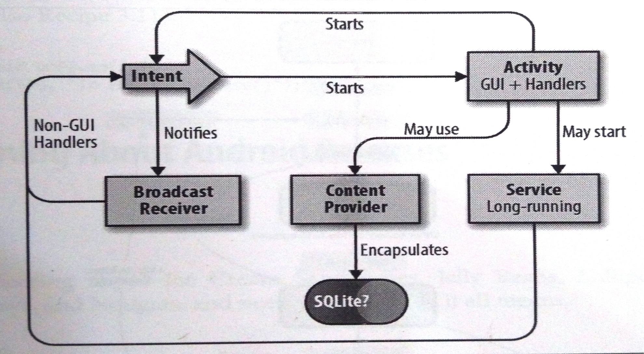
Android Application Components

Slide 38
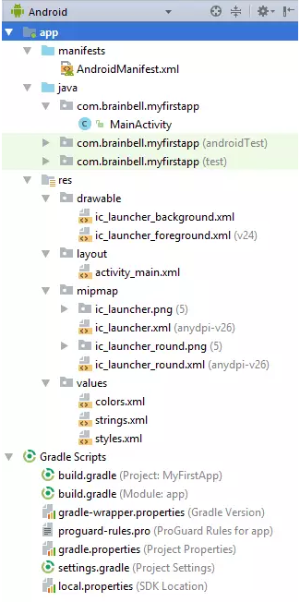
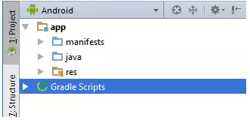
Anatomy of Android Project

Slide 39
Anatomy of Android Project
The Project tool window has several views, including the
  Android view
  Project view
  Packages view
Each view shows the same stuff, but each view organizes this stuff a bit differently
Android and Project are the most useful views, though the Android view may hide certain folders from you.
By default, Android Studio will set the view to Android.
The Project tool window provides a simple tree interface with files and nested folders that you can toggle.

Slide 40
Anatomy of Android Project
When you create an application in Android Studio, you find that the project is divided into an App folder and Gradle scripts.
The App folder contains three subfolders (manifests, java and res) that make up your application.

Slide 41
Anatomy of Android Project
1. Manifest Folder
This is where you would put your manifest files.
Most Android apps have single manifest file. But an app may have several manifest files due to application versioning, or for supporting specific hardware.
An “AndroidManifest.xml” file is generated inside manifest folder by Android Studio when you create a project.
This file contains the configuration parameters of the project such as permissions, services and additional libraries.
A manifest file also provides information to the OS and Google Play store about your app.

Slide 42
Anatomy of Android Project
2. Java Folder
This is the folder in your project where you will be storing all of the source code files written in Java programming language.
A MainActivity.java is automatically created in this folder by Android Studio.
All of your classes will be available here
Android Studio will even bundle together the package path so that you can work with the files without having to drill down through the folders that make up your package.

Slide 43
Anatomy of Android Project
3. Res Folder
It contains folders that help you separate and sort the resources of your application.
Resources basically mean all the needed files except the source code.
For example, while developing an app, you need to include resource files such as the app-logo, photos, sounds, videos or animations.
Each file type should be added to its own folder to comply with the Android development standards.

Slide 44
Resources
Android follows the philosophy of keeping application logic separate from the user interface.
Hence everything except the code is defined as resources separate from the code.
Following are different types of resources:
  Drawable
  Layouts
  Mipmap
  Values

Slide 45
Resources/Drawable
Drawables are graphics resources that can be painted on the screen. They include icons and images.
To cater to different screen sizes, we may have folders like res/drawable-ldpi, res/drawable-mdpi, res/drawable-hdpi, res/drawable-xhdpi, res/drawable-xxhdpi, etc. corresponding to screens with low, medium, high, extra-high and extra-extra-high DPI (Dots Per Inch) screens respectively.
Having different sized icons and images for different sized screens ensures that the application has nice looks on all types of devices.

Slide 46
Resources/Layouts
Layouts are ViewGroups that are not rendered (displayed) themselves, but are used to hold and organize other views geometrically on the screen.
layouts decide the sizes and arrangements of the views on screen at runtime.
Because there may be a wide variation in screen sizes between different devices, it is not recommended to use fixed sizes and positioning.
The typical way of constructing user interface screens is to define the layout in a layout file in XML format and then generate the necessary views at runtime from the XML definition. this process is called layout inflation.
Like drawables, we may define different layouts for different screen sizes and Android will pick the most suitable one based on the actual screen size at runtime.
We may also create views programmatically at runtime without defining them in an XML file.
Layouts can be nested one inside another to create a complex layout

Slide 47
Resources/mipmap
Devices have different resolutions so the launcher app show the icons on different resolutions.
Resource optimisation techniques sometimes removes resources for unused screen densities and when the launcher app has to upscale a lower-resolution icon for display it might look blurred.
  Launcher is the name given to the part of the Android user interface that lets users customize the home screen.
It makes sure launcher apps show a high-resolution icon for your app by moving all densities of your launcher icons to density-specific res/mipmap/ folders (for example res/mipmap-mdpi/ and res/mipmap-xxxhdpi/).
App uses mipmap/ folders instead of the drawable/ folders for launcher icons.

Slide 48
Resources/values
There are different types of values that are stored in XML files seperately from the code for easy changeability. They are:
Colors
  Colors are used to define basic colouring scheme of the app globally
Strings
  No string should be hard-coded anywhere in the application code or other resource files (e.g. layouts).
  All such strings, including labels for view on the screen, titles, menu item titles, etc. should be defined in the strings XML file.
  This enables internationalization, where the strings may be translated into different languages by non- developers or third parties without going through or having access to the source code.
  The systems picks the correct strings XML file at runtime based on the locale (language) settings in effect on the user's device

Slide 49
Resources/values
Styles
  Styles are used to define visual appearance of view.
  They work very similarly to CSS.
  To ensure maximum portability across different devices, one should never define any visual characterisitcs anywhere other than in styles.
  One style may inherit from another style. There are several built-in styles and a programmer may define one's own style as well.
  A style applied at the entire ap- plication level is called a theme.
  Themes are used to ensure consistent look and feel throughout the application.
  They also provide a central place for the styles for easy changeability and for avoiding duplication

Slide 50
Resources
Advantages of using Resources
  Separating the presentation from the logic
  Providing different screen layouts, menus and graphic resources (e.g. images/icons) for different screen sizes
  Ability to change the visual design of the app without affecting the code

Slide 51
Anatomy of Android Project
Gradle Scripts
Apk files are built using the gradle build system, which is integrated in the Android Studio.
When we start an app, the gradle build scripts are automatically created.
If you have special requirements for your project, you can specify these requirements here.
The gradle scripts folder contains the scripts used to build the app are:
  configuration files
  properties files
  setting files

Slide 52
Android Activity Lifecycle
The lifecycle of activities is managed by the Android system itself.
To conserve resources, especially battery power and memory, Android may terminate a running activity at any time.
The activity is supposed to save its state when an event signalling the possibility of such termination occurs.
When the activity is restarted, it is passed the previously saved state as a Bundle.
The activity should use it to restore itself such that the user has a seamless experience and does not realize that the activity was terminated and restarted in-between.

Slide 53
Android Activity Lifecycle
At any time, an activity may be in one of the following states.
Resumed (Running) An activity in this state is currently interacting with the user and has user focus in it.
  It is on the top of the Activity Stack.
  Such activity must continue running and update the UI and accept user input when needed, so it is never killed automatically by the Android system
Paused An activity in this state is not currently interacting with the user and does not have user focus in it.
  It is not on the top of the Activity Stack.
  However, because the top-of-the-stack activity does not occupy the whole screen, this activity is at least partially visible.
  It is desirable to keep such an activity running and updating its UI, so such activity is killed automatically by the Android system
Stopped An activity in this state is completely obscured by another activity (hidden behind that activity).
  While it may need to preserve its state (e.g. display), there is no need to waste CPU cycles on keeping it running.
  Such activity may be killed automatically by the Android system at any time

Slide 54
Android Activity Lifecycle
From the moment an activity appears on the screen to the moment it is hidden, it goes through a number of stages, known as an activity’s life cycle.
The Activity base class defines a series of events that govern the life cycle of an activity.
By default, the activity created for you contains the onCreate() event.
Within this event handler is the code that helps to display the UI elements of your screen.

Slide 55
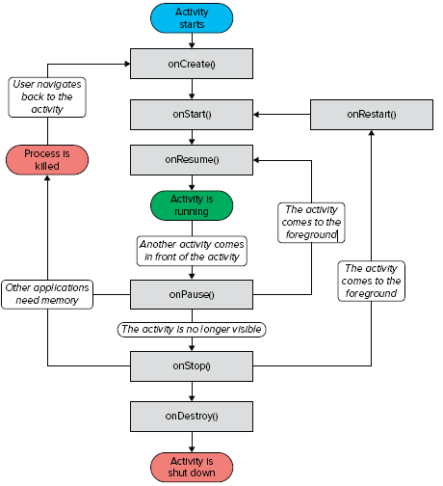
Activity Life Cycle
onCreate() — Called when the activity is first created
onStart() — Called when the activity becomes visible to the user
onResume() — Called when the activity starts interacting with the user
onPause() — Called when the current activity is being paused and the previous activity is being resumed
onStop() — Called when the activity is no longer visible to the user
onDestroy() — Called before the activity is destroyed by the system (either manually or by the system to conserve memory)
onRestart() — Called when the activity has been stopped and is restarting again

Slide 56
Activity Life Cycle (Remember This!!)
The onPause() method is called in both scenarios — when an activity is sent to the background, as well as when it is killed.
When an activity is started, the onStart() and onResume()methods are always called, regardless of whether the activity is restored from the background or newly created.
When an activity is created for the first time, the onCreate() method is called.

Slide 57
Activity Life Cycle (Remember This!!)
Use the onCreate() method to create and instantiate the objects that you will be using in your application.
Use the onResume() method to start any services or code that needs to run while your activity is in the foreground.
Use the onPause() method to stop any services or code that does not need to run when your activity is not in the foreground.
Use the onDestroy() method to free up resources before your activity is destroyed.
Even if an application has only one activity and the activity is killed, the application will still be running in memory.

